Slide 1
Crosswalk: Other States Social Emotional Learning Benchmarks
Presenter: Renee Noby, Research Analyst 2
OSPI Title II, Part A and Special Programs
Date: January 20, 2016

Slide 2



Links to SEL Standards
Alaska
Connecticut
Illinois
School Climate and Social and Emotional Learning:
http://alaskaice.org/school-climate/sel/
Early Learning and Development Standards:
http://www.ct.gov/oec/cwp/view.asp?a=4541&q=536726
Social Emotional Learning Standards:
http://www.isbe.net/ils/social_emotional/standards.htm

Slide 3



Links to SEL Standards
Kansas
Massachusetts
West Virginia
Social, Emotional, & Character Development Standards:
http://www.ksde.org/Default.aspx?tabid=482
Standards for Preschool and K Social & Emotional Learning
http://www.doe.mass.edu/kindergarten/SEL-APL-Standards.pdf
School & Community Social Skills Standards
http://wvde.state.wv.us/healthyschools/ElectronicManual4373New.html#SchoolandCommunitySocialSkillsStandards

Slide 4
Standards & Benchmarks
Examples of how other states have structured their SEL Standards and Benchmarks

Slide 5
Alaska (Anchorage SD K-12 SEL Standards) http://www.asdk12.org/media/anchorage/globalmedia/documents/professionallearningdept/SELStandardsAppend.pdf
4 Standards:
Self-awareness
Self-management
Social Awareness
Social Management
Student Indicators:
Early elementary (K-3)
Late elementary (4-6)
Middle school (7-8)
Early high school (9-10)
Late high school (11-12)
Example of Benchmarks:
Self-awareness
1A. | Student demonstrates awareness of his/her emotions.
1B. | Student demonstrates awareness of his/her personal traits.
1C. | Student demonstrates awareness of his/her external supports.
1D. | Student has a sense of personal responsibility.

Slide 6
Connecticut
5 Standards:
Early learning experiences will support children to…
Develop healthy attachments & relationships with primary caregivers.
Develop self-regulation.
Develop, express, recognize & respond to emotions.
Develop self-awareness, self-concept & competence.
Develop social relationships.
Student Indicators:
0-6 months
6-12 months
12-18 months
18-24 months
24-36 months
3-4 years
4-5 years

Slide 7
Connecticut Cont.
Example of Benchmark:
Benchmarks Associated with Learning Standard “Develop self-awareness, self-concept & competence,” within Age Level
Sense of Self
0-6 Months | React when hearing their own name through movement or expressions | Begin to realize their hands and feet belong to them and explore them as well as face, eyes and mouth
6-12 Months | Consistently respond to their name | Show awareness of body parts of self and others
12-18 Months | Demonstrates self-awareness through response to name and use of “me” and “mine” | Recognize self in mirror
18-24 Months | Identify own family members by relationship and/or name
24-36 Months | Identify self, family members, teacher and some peers by name
3-4 Years | Refer to themselves by first and last name and identify some characteristics (e.g., gender, hair color, etc.) and skills
4-5 Years | Identify themselves as an individual and a part of a group by sharing individual characteristics and roles within the group (e.g., name family members and roles, name team members or classmates)

Slide 8
Illinois
Goal 1: Develop self-awareness and self-management skills to achieve school and life success.
Identify and manage one’s emotions & behavior.
Recognize personal qualities & external supports.
Demonstrate skills related to achieving personal & academic goals.
Goal 2: Use social-awareness and interpersonal skills to establish and maintain positive relationships.
Recognize the feelings & perspectives of others.
Recognize individual & group similarities & differences.
Use communication & social skills to interact effectively with others.
Demonstrate an ability to prevent, manage, and resolve personal conflicts in constructive ways.
Goal 3: Demonstrate decision-making skills and responsible behaviors in personal, school, and community contexts.
Consider ethical, safety, and societal factors in making decisions.
Apply decision-making skills to deal responsibly with daily academic & social situations.
Contribute to the well-being of one’s school & community.

Slide 9
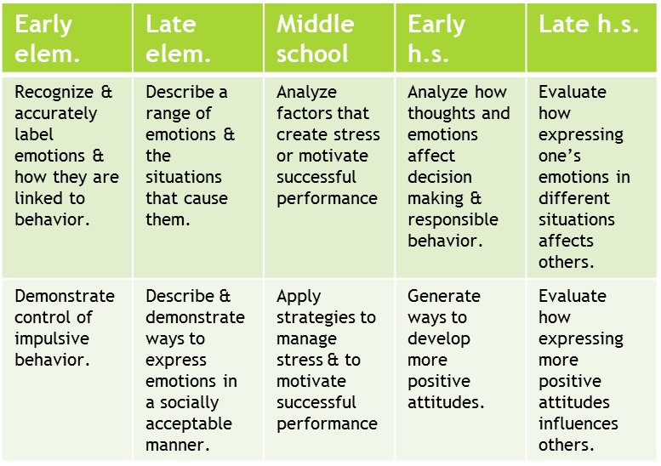
Illinois Cont.
Example of Benchmark:
Benchmarks Associated with Learning Standard 1A: “Identify & Manage One’s Emotions & Behavior,” within Grade Level
Student Indicators:
Early elementary
Late elementary
Middle school
Early high school
Late high school

Slide 10
Kansas http://www.ksde.org/Portals/0/Learning%20Services%20Documents/Fact%20Sheets/Social,%20Emotional,%20and%20Charcter%20Development%20Standards.pdf
3 Standards:
Character development
Core principles
Responsible decision making & effective problem solving
Personal development
Self-awareness
Self-management
Social development
Social awareness
Interpersonal skills
Student Indicators:
Grades K-2
Grades 3-5
Grades 6-8
Grades 9-12
Example of Benchmark:
Self-Awareness
 | Knowing | Doing
A. | Understand & analyze thoughts & emotions.
B. | Identify & assess personal qualities & external supports.

Slide 11
Massachusetts
10 Standards:
Goal 1: Self-awareness
Recognizing, Identifying & Expressing Emotions
Accurate Self-perception
Self-efficacy (confidence/competence)
Goal 2: Self-management
Impulse Control & Stress Management
Goal 3: Social Awareness
Empathy
Respect for Others
Goal 4: Relationship Skills
Communication
Social Engagement & Relationship Building
Conflict Management
Seeking Help & Offering Help
Goal 5: Responsible Decision Making
Personal, Social, & Ethical Responsibility
Reflection & Evaluation

Slide 12
Massachusetts Cont.
By the end of Preschool, a child may…
Recognize and label basic emotions & associate them with words, facial expressions, &/or gestures
Begin to develop a rich vocabulary to emotions/feelings
Express a range of emotions appropriately through gestures, actions, drawing, or language, with modeling & support
Demonstrate beginning understanding of connection between feelings & behaviors (e.g., “If…,then…”)
Example of Benchmark:
Benchmarks attached with Learning Standard 1: “The child will be able to recognize, identify, and express his/her emotions,” within Grade Level.
Student Indicators: Pre-K & K
By the end of Kindergarten, a child may…
Label basic emotions & recognize some complex emotions, & associate them with facial expressions, body language, & behaviors
Use richer & more specific vocabulary to the nuances of emotions
Express & share own feelings in a variety of ways
With support, describe reasons for own feelings & situations that cause them (stimuli/provocations)

Slide 13
West Virginia
3 Standards:
Self-awareness & Self-management
Social awareness & Interpersonal Skills
Decision-making Skills & Responsible Behaviors
Student Indicators:
Grades PK-1
Grades 2-4
Grades 5-8
Grades 9-12
Example of Benchmarks:
Grades 2-4 | Self-awareness & self-management
Objective: | Students will:
2-4.1.01 | Describe a range of emotions & the situations that cause them.
2-4.1.02 | Describe & demonstrate ways to express emotions in a socially acceptable manner.
2-4.1.03 | Describe personal skills & interests that one wants to develop.

